Slide 1
Liquids, Solids or Gases?
The Kinetic Molecular Theory & States of Matter in Equations

Slide 2
Learning Objectives
Students will be able to:
Understand the effects motion of atoms and molecules in chemical and physical processes.
Determine the state of matter of components in a chemical equation.

Slide 3
But first…..

Slide 4
In the honor of Super Bowl 49….
… let’s talk about Deflate-Gate

Slide 5
What is it?
#DeflateGate refers to the controversy surrounding the New England Patriots’ alleged use of deflated footballs towards the team’s advantage during their American Football Conference (AFC) Championship game against the Indianapolis Colts in January 2015. The accusations of foul play has prompted an investigation from the National Football League (NFL).
Excerpt from http://www.wthr.com

Slide 6
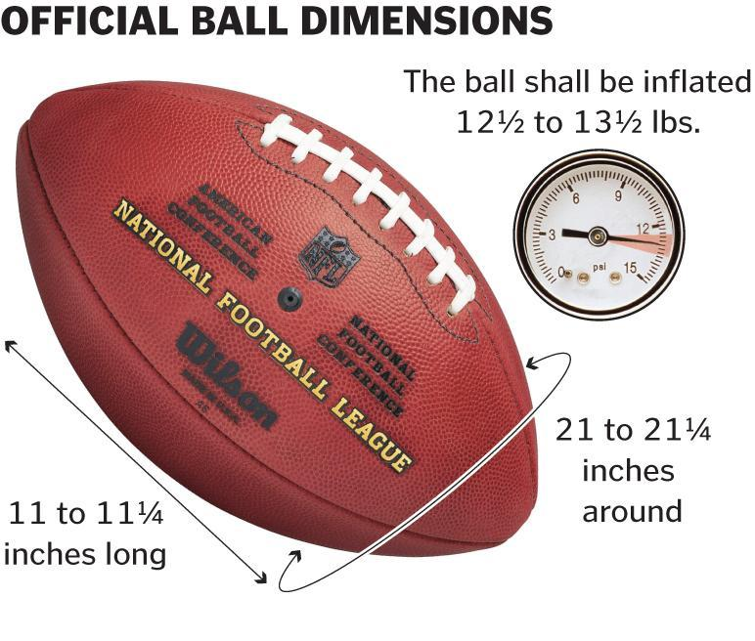
What are the Facts?
Balls were inflated prior to the game in the locker room. When the balls’ pressure was measured by officials during the game, it was found that 11 out of 12 balls were inflated 2 lbs less then the regulation.
Conditions in locker room: dry and 80 degrees F.
Conditions during game: wet and 50 degrees F.

Slide 7
How can this change in ball inflation be explained?
THINK-PAIR-SHARE
HeadSmart Labs "DeflateGate" Study
https://www.youtube.com/watch?v=CxsXFX3tDpg#t=71

Slide 8
So how did the balls deflate?

Slide 9
Kinetic Theory and the Gas Laws
10
10
10
10
(a)
(b)
(c)
original temperature
original pressure
original volume
increased temperature
increased pressure
original volume
increased temperature
original pressure
increased volume
Dorin, Demmin, Gabel, Chemistry The Study of Matter , 3rd Edition, 1990, page 323 (newer book)
Notes:
“Kinetic Theory and the Gas Laws”
Description: This slide shows three cylinders filled with equal masses of the same gas under different conditions. In cylinder (b), the pressure and temperature both have doubled from their values in cylinder (a). In cylinder (c), only the temperature has been doubled. The velocities of the gas particles are represented graphically to help students interpret the macroscopic changes in terms of the kinetic theory.
Basic Concepts
The kinetic theory can explain the combined gas law relationships of an ideal gas.
The pressure of a confined gas increases when the particles of the gas collide with the container walls more frequently or with greater force.
Teaching Suggestions
Use this slide to review the kinetic theory as it applies to the temperature, volume, and pressure of gases. Ask students whether the velocities of the gas particles would be the same for all gases at the same temperature. Point out that the average kinetic energy would be the same for all gases, but more massive gas particles would have slower velocities because mass and velocity are inversely proportional in the formula for kinetic energy: ½ mv².
Questions
The three cylinders in the diagram contain equal masses of the same gas under different conditions. Compare and contrast the conditions of the gas in each of the cylinders with respect to the pressure, volume, and temperature of the gas.
Cylinder (b) illustrates what happens when the gas in cylinder (a) is heated at constant volume. What happens to the average kinetic energy of the gas particles? How does this affect the velocity of the particles?
Use the kinetic theory to explain why the internal gas pressure in cylinder (b) is greater than the internal gas pressure in cylinder (a). What has been done to cylinder (b) to keep the gas volume the same as in cylinder (a)? Explain in terms of the equilibrium between internal and external pressure.
Suppose you are given the information that the temperature in both cylinder (b) and cylinder c) is double the temperature in cylinder (a). Compared with cylinder (a), how much greater is the volume in cylinder (c)? Explain how your answers illustrate the combined gas law (PV/T = constant).
Predict what would happen if you doubled the mass on top of the piston in cylinder (a), with the temperature constant. Use the kinetic theory to describe how this change would affect each of the following: volume, density, temperature, average velocity of the particles, rate of collision of the particles with the container wall, energy of these collisions, and internal pressure.
Suppose you take a basketball outside on a cold winter day. At first the basketball bounces normally, but then you notice that it starts to lose some of its bounce. Use the kinetic theory of gases to explain what is happening. Think of a few explanations. How could you determine which explanation is the best one?

Slide 10
The Kinetic Theory
List 2 characteristics for each state
In ONE sentence, explain the Kinetic Theory.
https://www.youtube.com/watch?v=8bGYV6ypP5o

Slide 11
Brainstorm…
Why is important to know the state of the compounds you are using in your reactions? (HINT: think about H₂O)

Slide 12
Determining States of Matter
All chemical species have a phase or state – either solid (s), liquid (l), gas (g) or in solution (aq).
There are rules to determine which state the species is in, within the reaction.
Elements – check the periodic table
If you know you have a solution, write (aq)
All ionic compounds, unless they are in solution, are solids (s).
All acids are in solution (aq)
All molecular oxides are gases (g).
If there are any species that don’t fit these rules, you would have to be given the state.

Slide 13
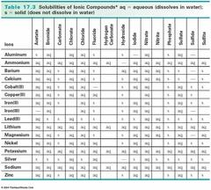
The tricky part is determining if an ionic compound is going to be solid (s) or in solution (aq).
If there is water in any equation, either as a reactant or product or any chemical species is in solution, you must look up the solubility table to determine if any ionic compounds in the reaction will dissolve to make a solution (aq).

Slide 14
HINTS & EXCEPTIONS
All metals are solids at room temperature EXCEPT for Mercury and Bromine.
Noble Gases are always gaseous.
Water is always liquid at room temperature.
Non-metals are often diatomic and gases.
Alcohols are liquid at room temperature.
Hydrocarbons (C_{x}H_{y}) are a gas if x<5 & a liquid if 4<x< 13, at room temperature.

Slide 15
PRACTICE
For each of the following, write a balanced chemical reaction equation (including states of matter) that accurately represents the process described:
When dissolved beryllium chloride reacts with dissolved silver nitrate in water, aqueous beryllium nitrate and silver chloride powder are made.
When isopropanol (C3H8O) burns in oxygen, carbon dioxide, water, and heat are produced.
When dissolved sodium hydroxide reacts with sulfuric acid (H2SO4), aqueous sodium sulfate, water, and heat are formed.
When fluorine gas is put into contact with calcium metal at high temperatures, calcium fluoride powder is created in an exothermic reaction.
When sodium metal reacts with iron (II) chloride, iron metal and sodium chloride are formed.

